Slide 1
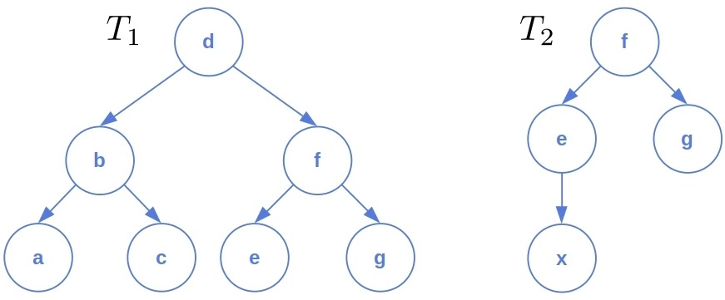
Tree Distance
Raghuveer Gummadi
Eunice Olorunshola
Vijaya Lakshmi Kocherla
Sahid Kebe
Group 3
11/29/2022
CSC 8540 Advanced Algorithms in Bioinformatics

Slide 2
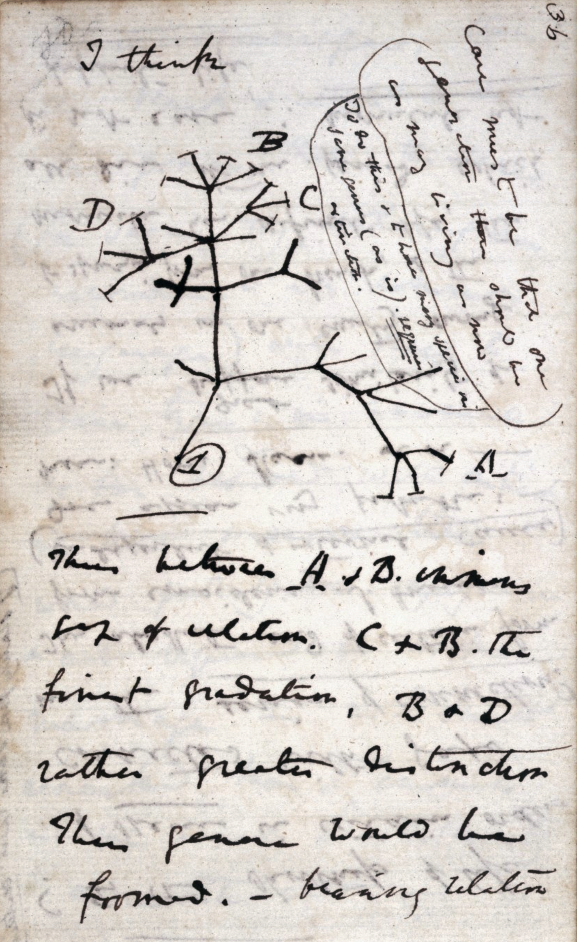
Introduction
Phylogenetic trees describe the evolutionary history of organisms, and researchers construct these trees using a variety of different methods. This can result in a several possible trees for a set of organisms
For example, parsimony, maximum likelihood, distance based.
Thus we need a way to quantitatively compare different phylogenetic trees.
One method to this is through BHV (Billera, Holmes, Vogtmann) Space, and its related distance measure, geodesic distance.

Slide 3
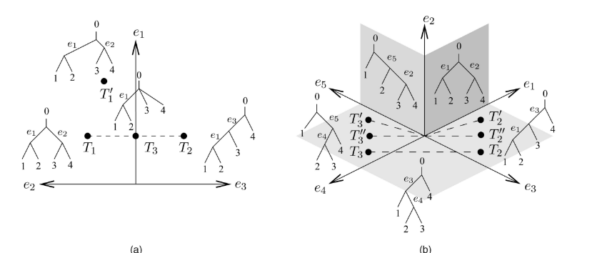
BHV Space
Metric space to represent trees
Distance between trees is a measure of the difference in topologies and internal branch lengths.
Every tree topology is it’s own orthant, which is a generalized version of a quadrant.
Edge length denotes position on orthant
(Owen, Provan 2011)

Slide 4
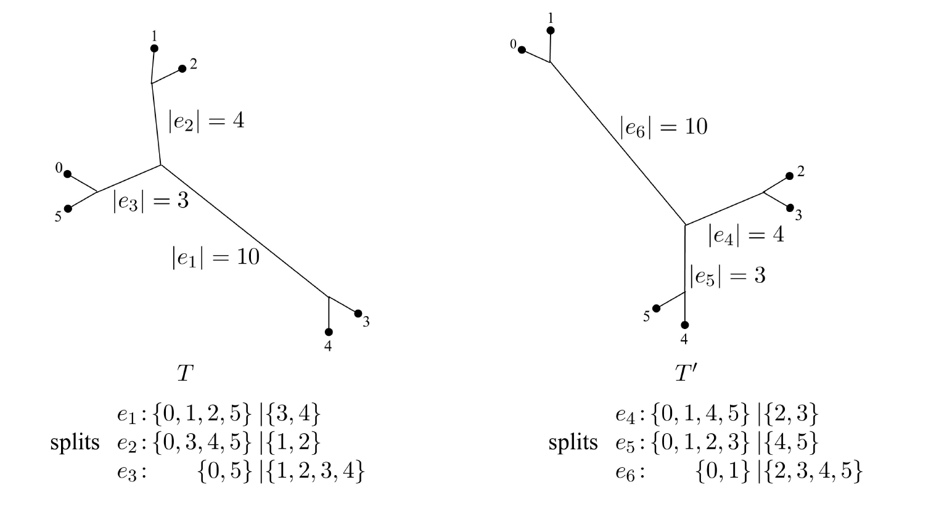
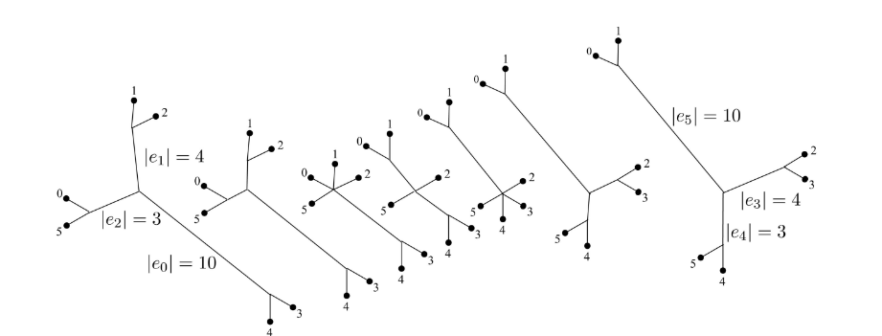
Geodesic Distance
Unique shortest distance between two trees in BHV space
Any point along a geodesic is a valid tree
The tree that is halfway between two trees on a geodesic path is an average, a Fréchet mean.

Slide 5
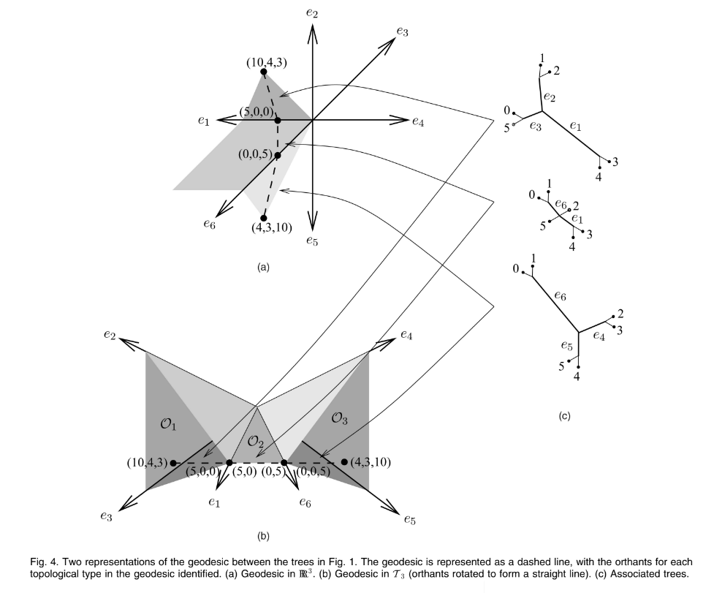
Geodesic Distance
Since each orthant is locally a Euclidean space, the shortest path between two points within a single orthant is a straight line.
The difficulty comes in establishing which sequence of orthants joining the two topologies will contain the geodesic. In the case of four leaves, we could do this through a brute-force search, but we cannot hope to do so with larger trees.
Owen and Provan introduced a polynomial time algorithm for finding a geodesic path. Once the path is known, computing its length is a simple matter.

Slide 6
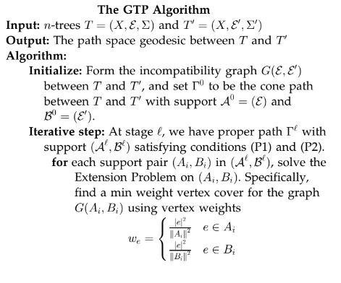
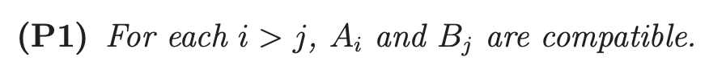
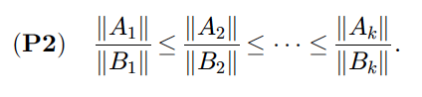
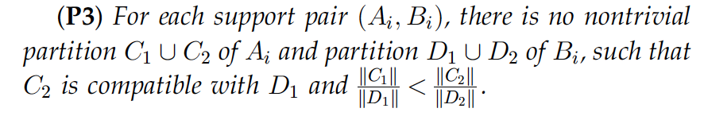
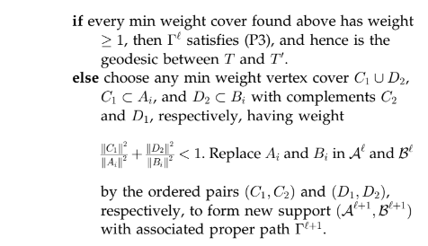
Geodesic Algorithm

Slide 7
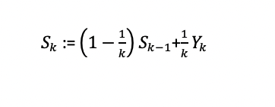
Fréchet Mean
A point in tree space that minimizes its sum of squared geodesic distances to the sample points
Given a finite point set T = {T1, . . . , Tr} of trees in Tn, the mean of T , alternatively known as the Fréchet mean, is the tree T ∈ Tn that minimizes the sum S (X,T) of the squares of the distances from X to the points in T.
When T = {T1,....,Tr} of trees in Tn is the set of input trees with finite point sets then the mean is the unique minimizer of the Frechet function
For a given data set of n phylogenetic trees T1, T2, …..Tn in Tr , the Frechet function is the sum of squares of geodesic distances from the data tree to a variable tree X
The set of all minimizers computed are the mean set.
Can be calculated using the inductive mean algorithm method and has been called the Strum algorithm
Explanation of the equation on the right , the right hand side indicates
the point 1/k fraction of the distance along the geodesic from sk-1 to Yk.
The point Sk is the inductive mean value of Y1…., Yk.
The expected squared distance computed between Sk and the point set T is less than or equal to F(T)/k .
Examples : Arithmetic mean and median , geometric mean , harmonic mean , power means , f-means , and weighted means.

Slide 8
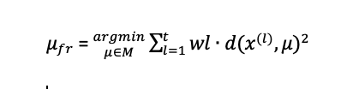
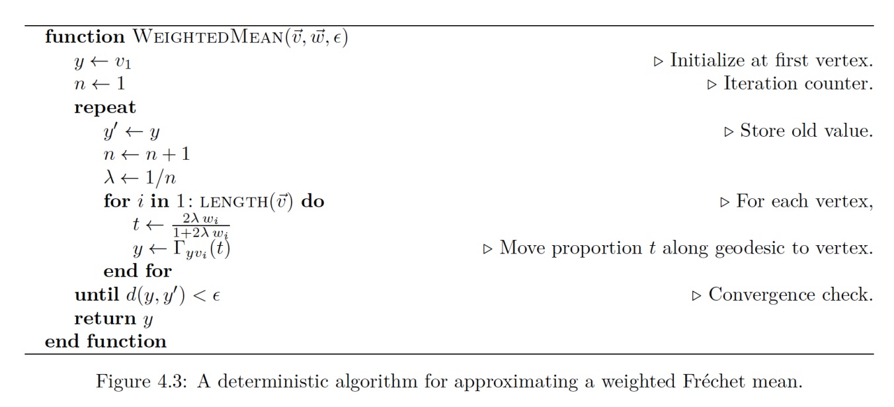
Algorithm for Fréchet Mean of Geodesic Distance
M. Bacak creates an algorithm for mean and median trees. Used in combination with other
For positive weights the weighted Frechet mean can be defined as

Slide 9
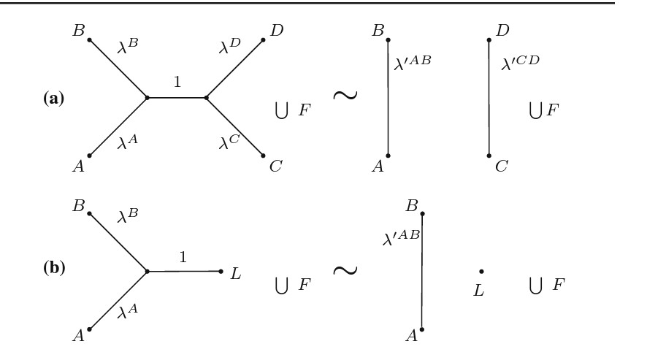
Wald Space
Alternative viewport of phylogenetic trees by regarding them as Markov models for sequence evolution
Related to edge-product space, defining it as a quotient space which adds trees w/infinitely long edge to BHV tree space.

Slide 10
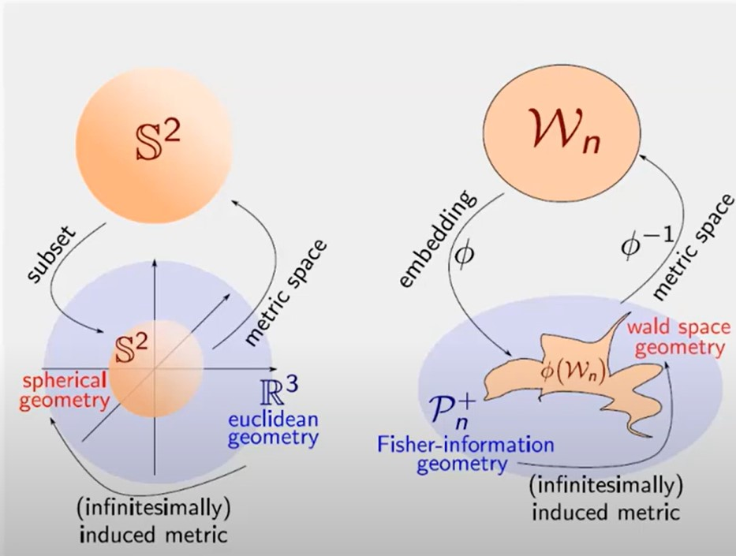
Construct Wald Forest
Let W_{N} be the collection of forests satisfying the necessary and sufficient conditions for each F € W_{N}
The forest F contains exactly N labelled vertices, these are called leaves and labelled 1…N
There are no unlabelled vertices in F in degree 0, 1, 2.
For every pair of leaves u, v in the same tree in F, at least one edge e on the unique path from u to v satisfies ⋋^{e} > 0.
· Wald space is the set W_{N}:= {F | F forest “with taxa” }
· Given F € W_{N}, let d_{uv} be the distance between connected taxa u and v, where u,v € {1…..n}
· (∑_{F})_{uv} = · { exp(-d_{uv}) if u and v are connected
{ 0, else
· Φ: W_{N} -> P⁺_{N}, F -> ∑_{F­} is injective

Slide 11
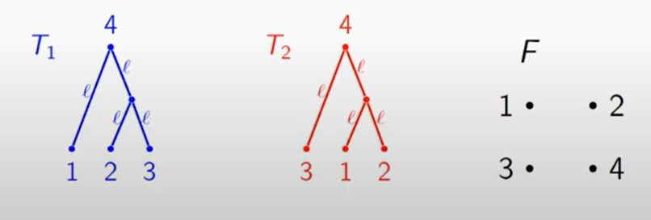
Result - Wald Forest
Wald space BHV⁺_{n -1}⊂ W_{N}
dW_{N}(F₁,F₂) < ∞ for all F₁,F₂ ∈ W_{N}
dW₄(T₁,F), dW₄(T₂,F), dW₄(T₁,T₂) -> 0 as ℓ -> ᪲᪲∞

Slide 12
Putting it all together

Slide 13
Proposed Method
Comparative study of tree distance between Wald Space and BHV
At the same time compare phylogeny reconstruction methods
Construct trees using the same set aligned sequences with different methods.
Evaluate distance and medians between those trees to quantitatively judge tree reconstruction methods
Introduce a robust framework for evaluating both of those things metric spaces

Slide 14
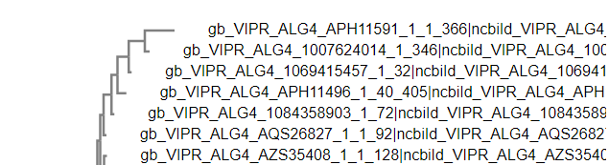
Example Dataset
We plan on using at least two organism for our data sets
Zilka
Apicomplexa
https://github.com/grady/kdetrees/tree/master/data
All data will be stored in https://github.com/RagDoll95/TreeSpace/tree/master/data
FASTA of the capsid protein of the ZILKA virus retrieved from: The Bacterial and Viral Bioinformatics Resource Center (BV-BRC), https://www.bv-brc.org/
Aligned and then generated tree using EMBL-EBI tool

Slide 15
Questions?
ggggg

Slide 16
References
Louis J Billera, Susan P Holmes, and Karen Vogtmann. Geometry of the space of phylogenetic trees. Advances in Applied Mathematics, 27(4):733–767, 2001.
Megan Owen and J Scott Provan. A fast algorithm for computing geodesic distances in tree space. IEEE/ACM Transactions on Computational Biology and Bioinformatics, 8(1):2–13, 2011.
Arindam RoyChoudhury, Amy Willis, and John Bunge. Consistency of a phylogenetic tree maximum likelihood estimator. Journal of Statistical Planning and Inference, 161:73–80, 2015.
Garba, M.K., Nye, T.M.W., Lueg, J. et al. Information geometry for phylogenetic trees. J. Math. Biol. 82, 19 (2021). https://doi.org/10.1007/s00285-021-01553-x
Miroslav Baˇca ́k. Computing medians and means in Hadamard spaces. SIAM Journal on Optimization, 24(3):1542–1566, 2014.
Garba, M.K., Nye, T.M.W., Lueg, J. et al. Information geometry for phylogenetic trees. J. Math. Biol. 82, 19 (2021). https://doi.org/10.1007/s00285-021-01553-x
Introducing the Bacterial and Viral Bioinformatics Resource Center (BV-BRC): a resource combining PATRIC, IRD and ViPR. Olson RD, Assaf R, Brettin T, Conrad N, Cucinell C, Davis JJ, Dempsey DM, Dickerman A, Dietrich EM, Kenyon RW, Kuscuoglu M, Lefkowitz EJ, Lu J, Machi D, Macken C, Mao C, Niewiadomska A, Nguyen M, Olsen GJ, Overbeek JC, Parrello B, Parrello V, Porter JS, Pusch GD, Shukla M, Singh I, Stewart L, Tan G, Thomas C, VanOeffelen M, Vonstein V, Wallace ZS, Warren AS, Wattam AR, Xia F, Yoo H, Zhang Y, Zmasek CM, Scheuermann RH, Stevens RL. Nucleic Acids Res. 2022 Nov 9:gkac1003. doi: 10.1093/nar/gkac1003. Epub ahead of print.
Lueg, J., Garba, M.K., Nye, T.M.W., Huckemann, S.F. (2021). Wald Space for Phylogenetic Trees. In: Nielsen, F., Barbaresco, F. (eds) Geometric Science of Information. GSI 2021. Lecture Notes in Computer Science(), vol 12829. Springer, Cham. https://doi.org/10.1007/978-3-030-80209-7_76
Weyenberg, Grady S., "STATISTICS IN THE BILLERA-HOLMES-VOGTMANN TREESPACE" (2015). Theses and Dissertations--Statistics. 12. https://uknowledge.uky.edu/statistics_etds/12
Skwerer, Sean. “Tree Oriented Data Analysis .” North Carolina , 2014, pp. 1–83.
Bhattacharya, Rabi, and Vic Patrangenaru. "Large sample theory of intrinsic and extrinsic sample means on manifolds—II." The Annals of Statistics 33.3 (2005): 1225-1259.
Charlier, Benjamin. "Necessary and sufficient condition for the existence of a Fréchet mean on the circle." ESAIM: Probability and Statistics 17 (2013): 635-649. <http://eudml.org/doc/274376>.
Miller, Ezra et al. “Averaging metric phylogenetic trees.” ArXiv abs/1211.7046 (2012): n. pag.

